Slide 1
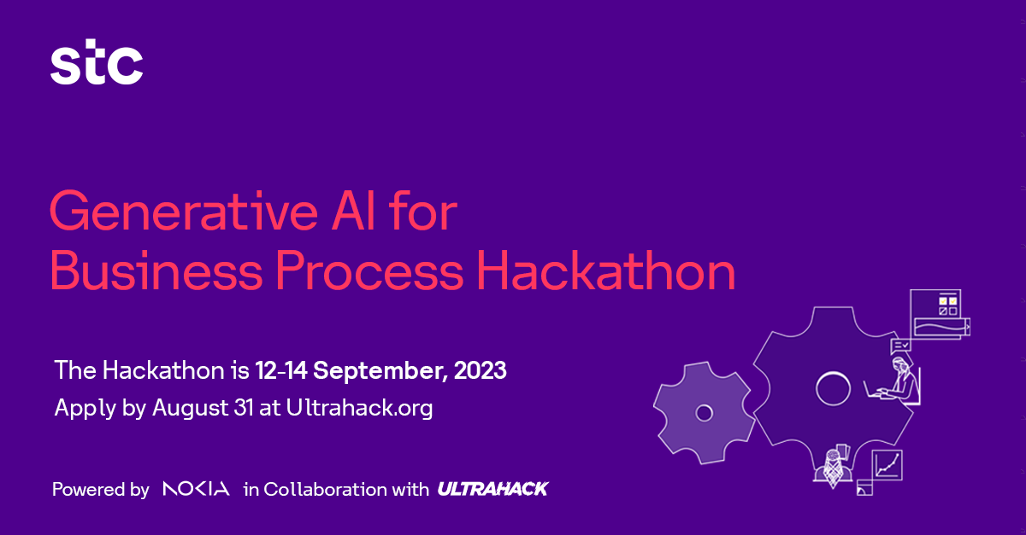



Powered by in collaboration with

Slide 2


GeniTalk
Njoud Alanazi
Information Systems student
Reyouf Alanazi
Information systems student
Sama AlOthmam
Information systems student
Layan Alamri
Information systems student
Powered by in collaboration with

Slide 3




Introduction
Expenses on customer service in 2022
4.5bilion
One of the most important aspects of the STC customer service system is that it targets a very large segment, so it should provide good customer service. Based on the problems we have observed in STC, especially in customer service and technical support, these problems include:
Percent of cost increase over last year
10%
Unsatisfactory user experience.
pressure on customer service
High operational costs
Delayed information
updates
These problems have led us to consider a method to facilitate customer service using generative artificial intelligence (AI).
Powered by in collaboration with

Slide 4
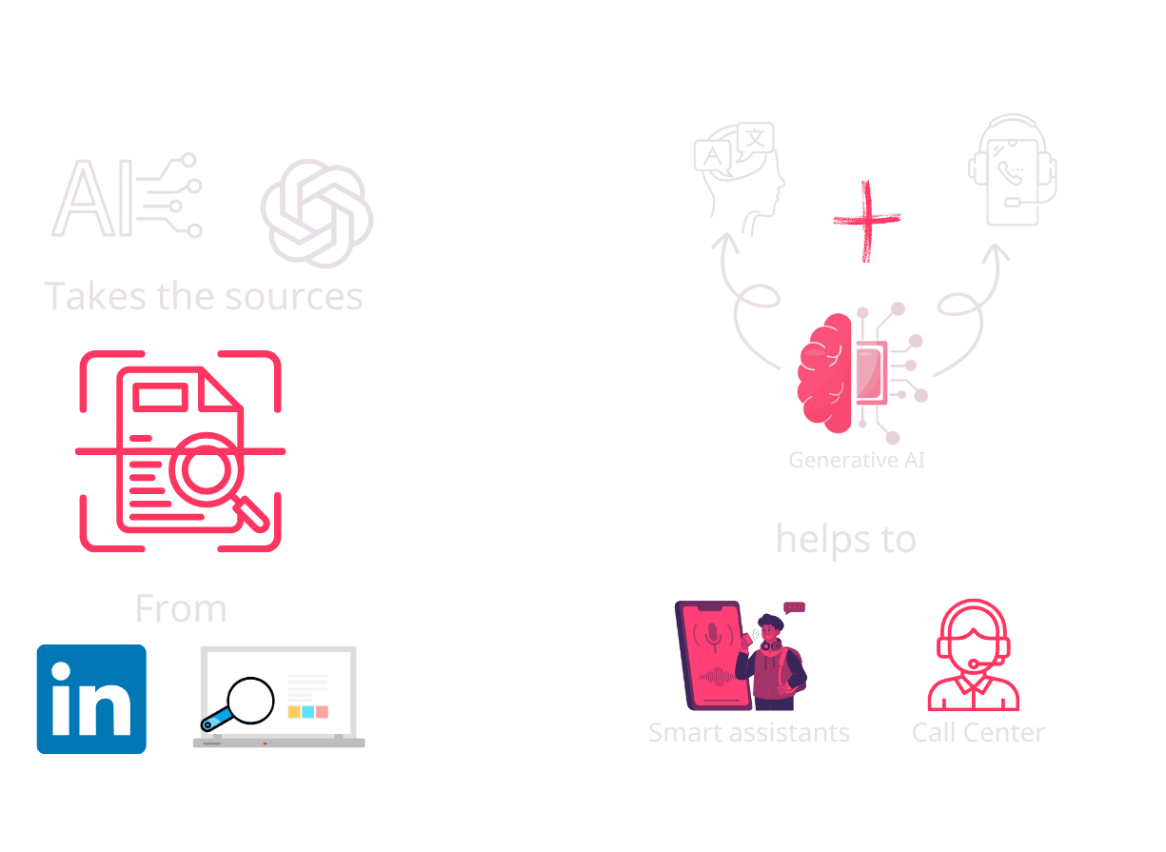
Background
Powered by in collaboration with

Slide 5




Description
Our idea revolves around a system that uses generative artificial intelligence that combines voice and linguistic communication, where the system learns several functions, such as:
Learns from data and can understand and generate natural language similarly to a human.
Obtains resources through chatgpt or scan information from the company's official pages on social networking sites
Links the model with the company's website so that the data is up to date.
The system enables seamless and intelligent communication with users, including:
answering voice and text commands
answering questions
understanding languages
customizing
interactions
This system can be used in multiple areas such as customer service, smart assistants in mobile phones, and smart device interactions in homes.
Powered by in collaboration with

Slide 6



Main Business processes
1. Providing technical support:
2. Managing customer problems:
3. Customer satisfaction evaluation:
Streamlined technical support with AI-powered assistance capable of learning and generating natural language responses, resulting in quicker issue resolution and improved support efficiency.
Enhanced problem management by enabling the system to access resources from official company pages and the website, ensuring accurate and up-to-date information for addressing customer inquiries.
seamless and intelligent communication, leading to more comprehensive feedback and insights for evaluation purposes.
Powered by in collaboration with

Slide 7
Business Canvas
Key activities: - Software development - System training - User interface development - Effective translation | Value proposition: - Enhanced communication experience - User personalization | Channels: - STC Mobile application | Key resources: - AI Experts and Engineers - data Infrastructure - Partnership | Customer segments: - stc customers - Call Center Companies - Call Center team
Key partners: - AI technology providers - STC & STC Groups | Revenue streams: - Advertising and Marketing: - Partnerships and cooperatives: | Cost structure: - Software development and periodic updates - Infrastructure and communications technology - Customer Support |  | Customer Relationship: - Customer service - Continuous interaction - Customer Satisfaction
Powered by in collaboration with

Slide 8
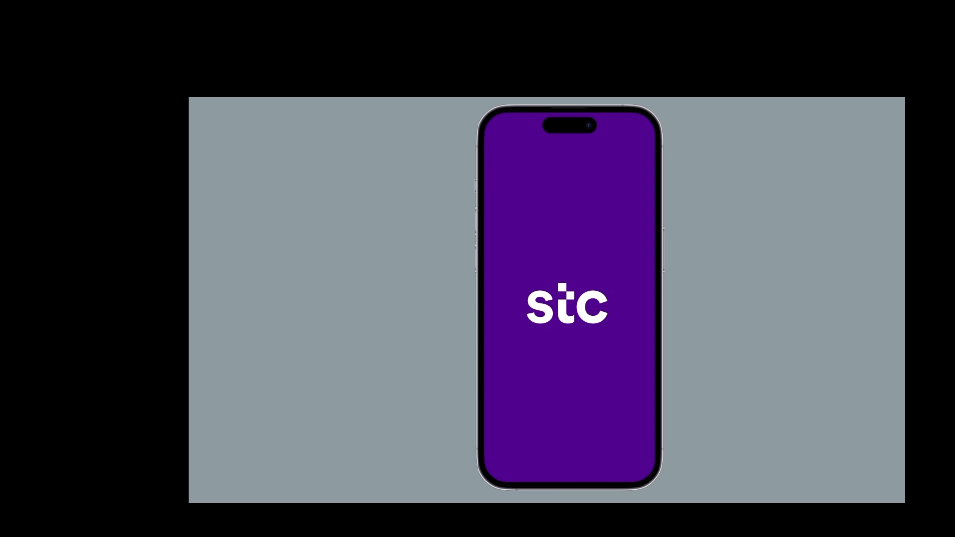

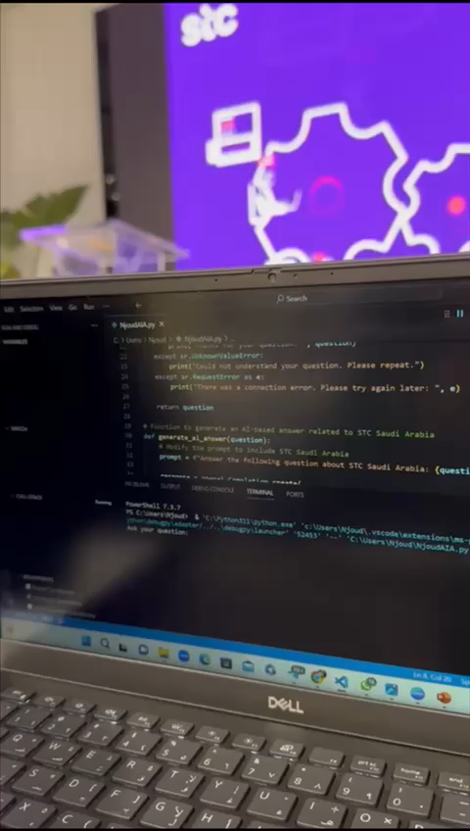


Demo
Prototype
GitHub
Powered by in collaboration with

Slide 9
Requirements for Prototype
We built this model using ChatGPT to give you an idea about the solution, we can train the model on STC data or other company which adopts the solution to get more customizable results
1. Data Preparation:
- Define objectives and use cases.
3. Data Representation:
- Convert data to suitable formats (e.g.,
numerical vectors, images, sequences).
5. Monitoring and Maintenance:
- Implement continuous learning and updates.
- Ensure security and privacy compliance.
2. Model Development:
- Decide on appropriate ML/DL models
(e.g., GPT-3, BERT, DeepSpeech) and train it.
4. Data Augmentation:
- Enhance dataset with variations and noise.
To build this self-learning AI system for advanced communication is an ongoing process. It requires a multidisciplinary team of data scientists, machine learning engineers, linguists, and domain experts to ensure its success. Additionally, staying up-to-date with the latest advancements in AI and NLP is essential.
Powered by in collaboration with

